Slide 1
Advanced Practical Course: Data Science
Prof. Dr. Xiaoming Fu
M.Sc Jiaquan Zhang
(jiaquan.zhang@cs.uni-goettingen.de)

Slide 2
Why Data Science?
“The demand for data scientists is increasing so quickly, that McKinsey predicts that by 2018, there will be a 50 percent gap in the supply of data scientists versus demand.” – The Alexa Blog (http://blog.alexa.com/know-data-science-important/)

Slide 3
What is the data about?
Rides of Yellow Cabs (taxis) in New York
June 2016
~11 million rides
19 features
geolocation, time and date, distance, fares, …
14 in test data set (+id)
Fare_amount
Extra
MTA
Tip_amount
Total_amount

Slide 4
What is the data about?
Six rate codes:
Standard metered fare
$2.5 initial charge
When faster than 6mph: 50ct per 0.2 mile
When slower than 6mph: 50ct per minute
50ct overnight surcharge (8pm to 6am), $1 rushhour surcharge (4pm to 8pm on weekdays)
Extra charges: 30ct improvement surcharge, up to 50ct MTA surcharge, tolls
Tips when paying with credit card (payment_type 2)

Slide 5
What is the data about?
Six rate codes:
Standard metered fare
Trips to/from JFK Airport
$52 flat
$4.5 rush-hour surcharge (4pm to 8pm on weekdays)
Extra charges: 30ct improvement surcharge, up to 50ct MTA surcharge, tolls

Slide 6
What is the data about?
Six rate codes:
Standard metered fare
Trips to/from JFK Airport
Trips to Newark Airport
Uses standard metered fare (everything from 1 applies)
$17.50 Newark Surcharge

Slide 7
What is the data about?
Six rate codes:
Standard metered fare
Trips to/from JFK Airport
Trips to Newark Airport
Out of Town Trips (to/from Manhattan from/to Westchester & Nassau Counties)
In town: standard metered fare (see 1)
Out of town: doubled standard metered fare
All charges apply

Slide 8
What is the data about?
Six rate codes:
Standard metered fare
Trips to/from JFK Airport
Trips to Newark Airport
Out of Town Trips (to/from Manhattan from/to Westchester & Nassau Counties)
Negotiated Trips (everywhere else)
Flat rate is negotiated before the ride
50ct MTA and 30ct improvement surcharge apply

Slide 9
What is the data about?
Six rate codes:
Standard metered fare
Trips to/from JFK Airport
Trips to Newark Airport
Out of Town Trips (to/from Manhattan from/to Westchester & Nassau Counties)
Negotiated Trips (everywhere else)
Group rides
Two possible routes with specific pickup and dropoff locations
Flat price per person

Slide 10
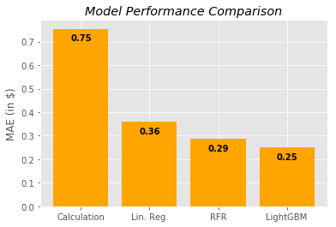
Algorithm Selection

Slide 11
Algorithm Selection

Slide 12
Algorithm Selection

Slide 13
Algorithm Selection

Slide 14
Algorithm selection

Slide 15
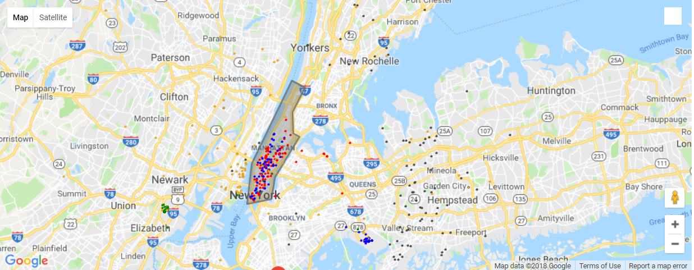
Dropoff-locations per ratecode
Standard Rate (1)
JFK (2)
Newark (3)
Out of Town (4)
Negotiated (5)

Slide 16
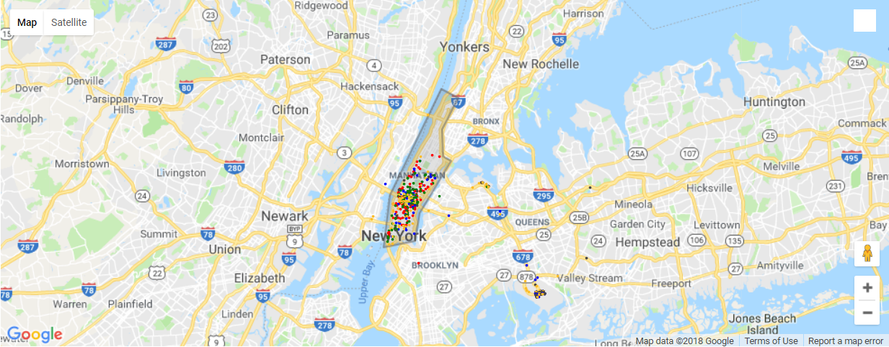
Pickup-locations per ratecode
Standard Rate (1)
JFK (2)
Newark (3)
Out of Town (4)
Negotiated (5)

Slide 17
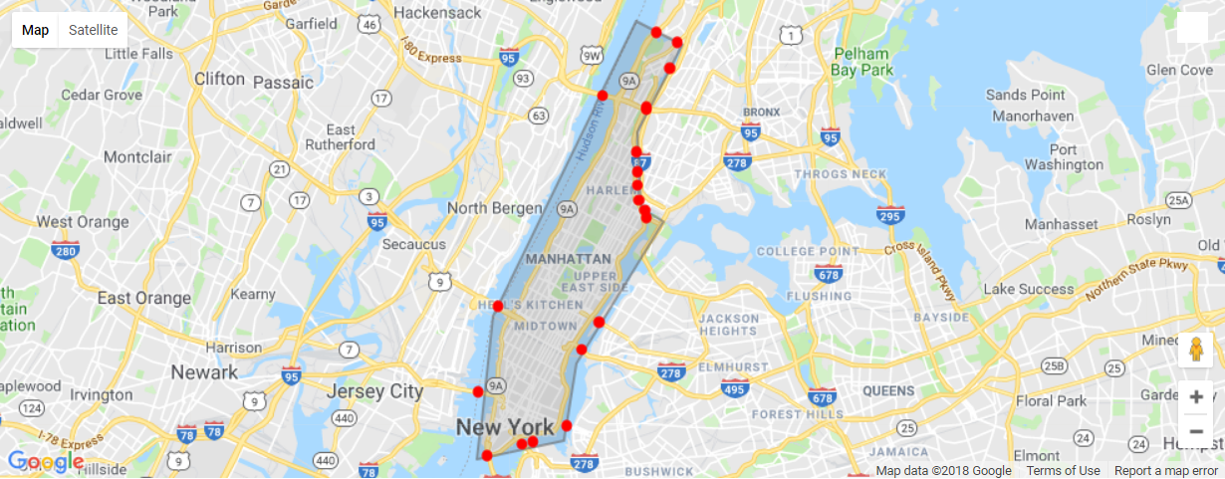
Bridge/tunnel positions

Slide 18
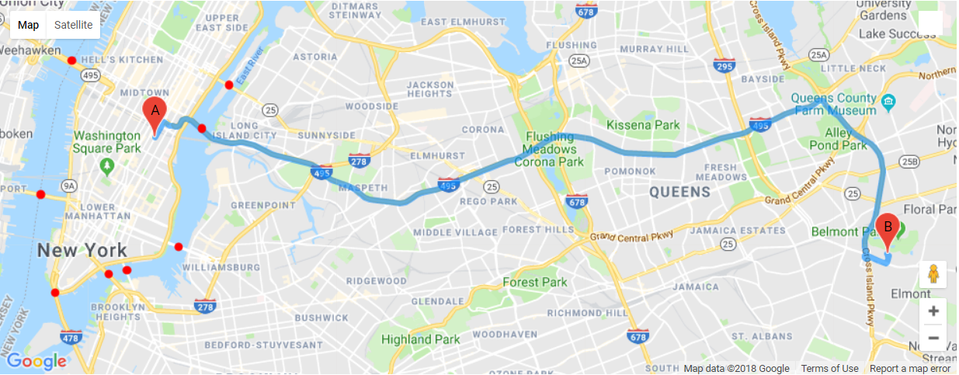
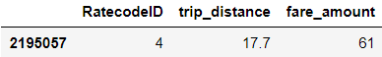
Bridge calculations (2195057)

Slide 19
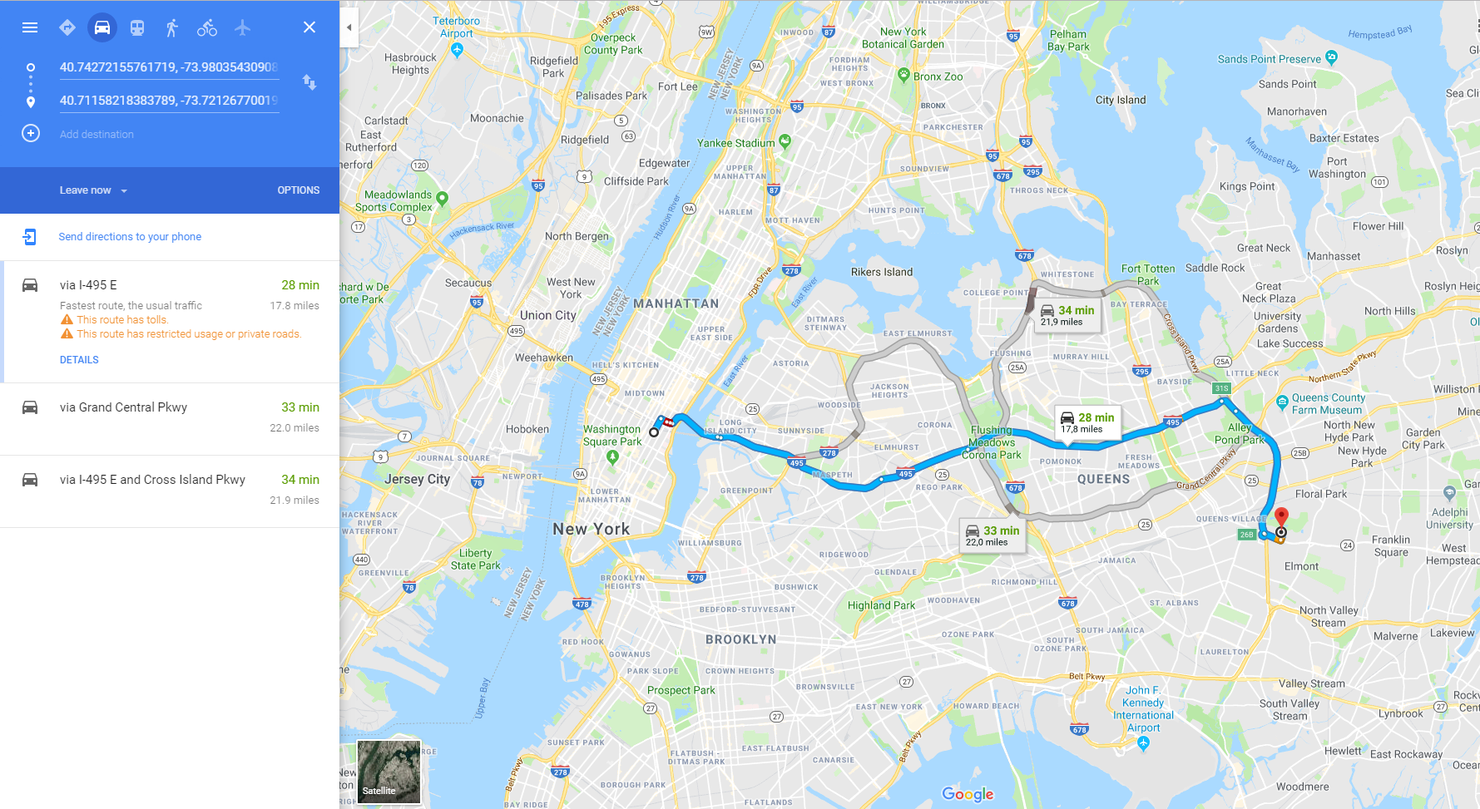
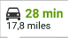
Bridge calculations (2195057)

Slide 20
Bridge calculations (2195057)
A
B
C

Slide 21
Bridge calculations (2195057)
A
B
C

Slide 22
Bridge calculations (2195057)
0.87 miles
12.9533 miles

Slide 23
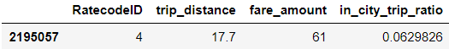
Bridge calculations (2195057)
0.87 miles
12.9533 miles

Slide 24
Bridge calculations (2195057)
0.87 miles
12.9533 miles

Slide 25
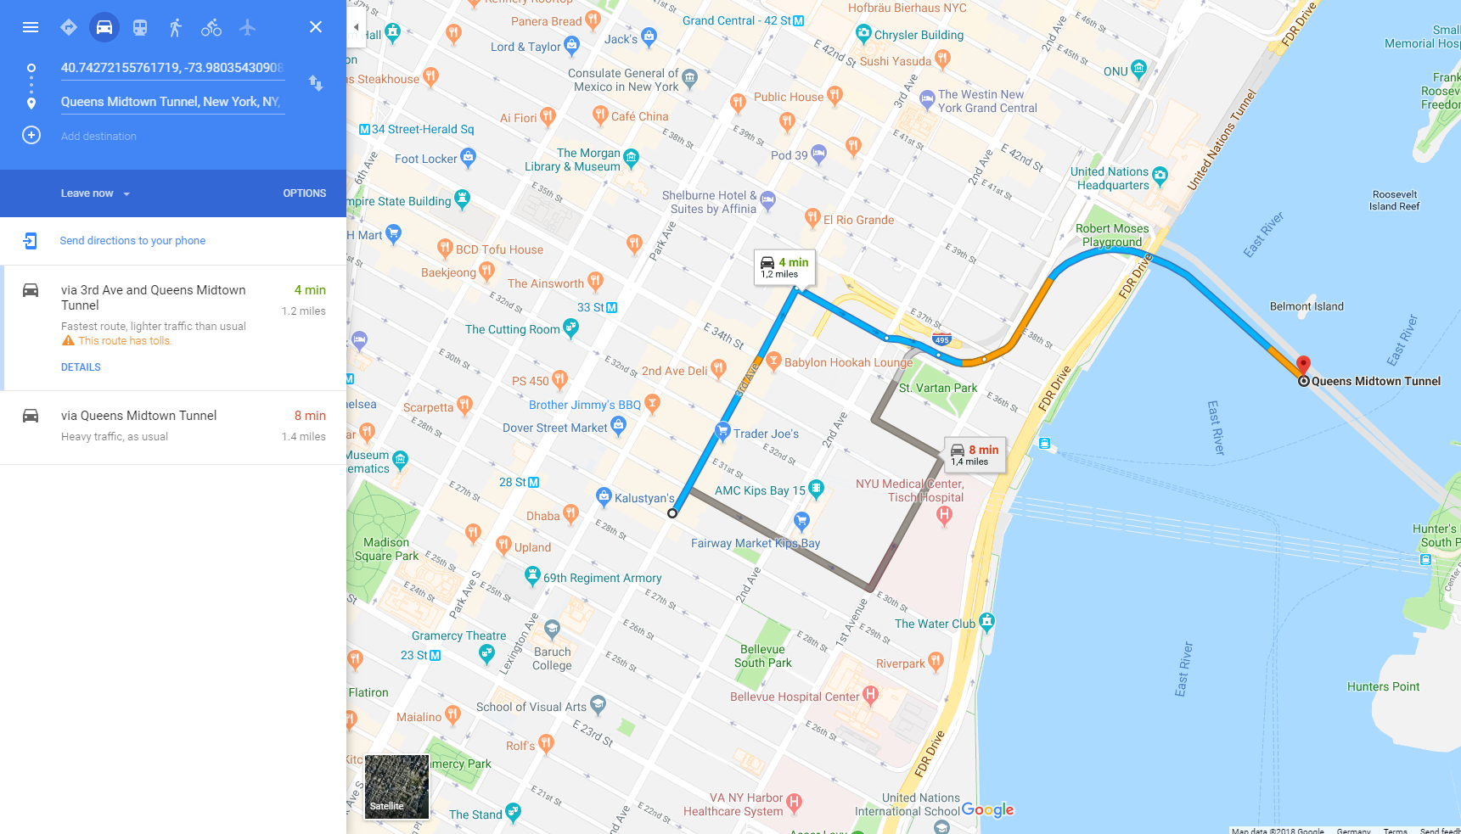
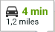
Bridge calculations (2195057)

Slide 26
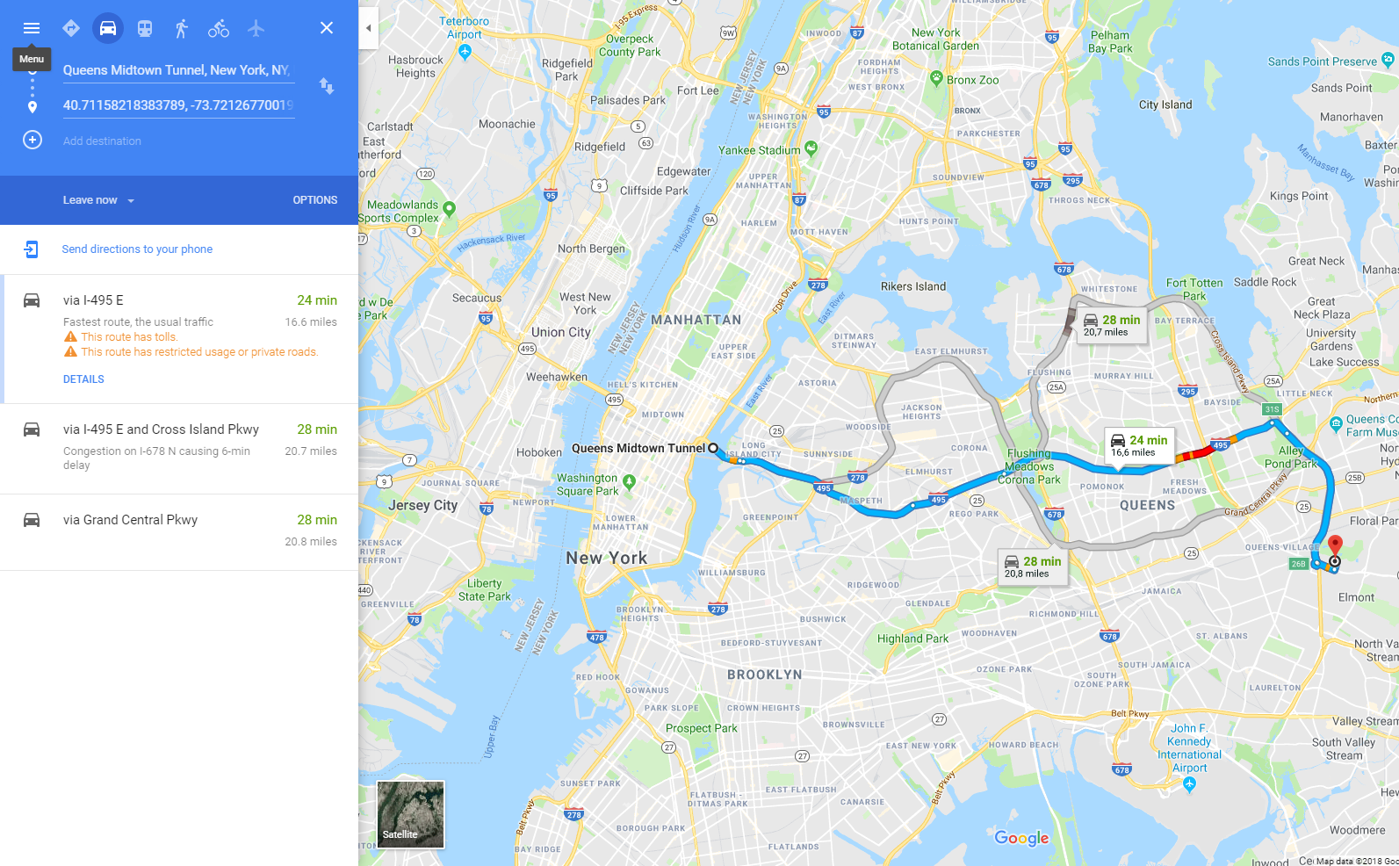
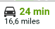
Bridge calculations (2195057)

Slide 27
Problems
Assumption 1: Bridge that minimize air-line distance is actually used
Different route
Non-linear route
Assumption 2: air-line distance ratio represents real inner-city to outer-city trip distance ratio
Different shape of route in city vs out of city
Extra destinations possible

Slide 28
Extra Prediction
Rush Hour
Between 16 – 20
Only on Workdays
Ratecodes 1, 2, 3, 4
$4,50 for Ratecode 2
Extra
Between 20 - 08
Everyday
Ratecodes 1, 3, 4

Slide 29
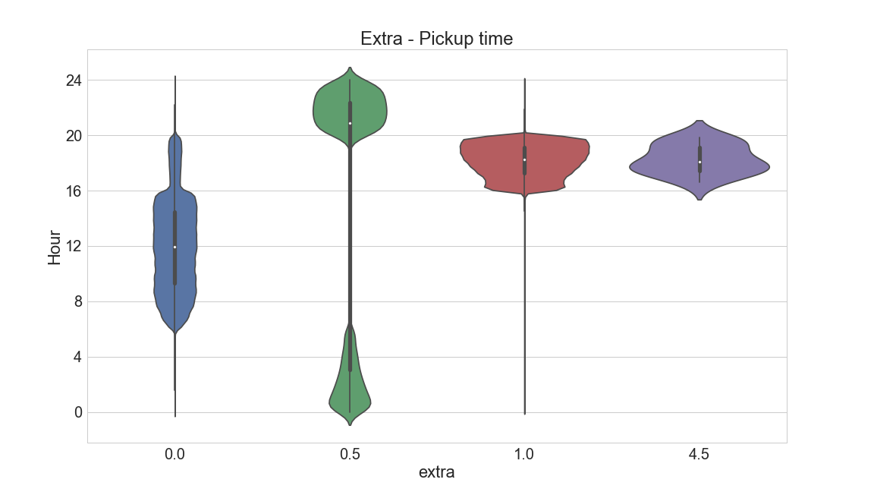
Extra Prediction
No Extra
Overnight
Rush Hour
Rush Hour JFK

Slide 30
Extra Prediction
No Extra
Overnight
Rush Hour

Slide 31
Extra Prediction
No Extra
Overnight
Rush Hour

Slide 32
Extra Prediction - Calculation
MAE:
0.006

Slide 33
Extra Prediction

Slide 34
Extra amount by Dropoff time (2)

Slide 35
Tip Prediction
What features affects tipping behavior?
How does tipping look like?
What problems are there with predicting tips?

Slide 36
Tipping Behavior

Slide 37
Tipping Behaviour

Slide 38
Tipping Behaviour

Slide 39
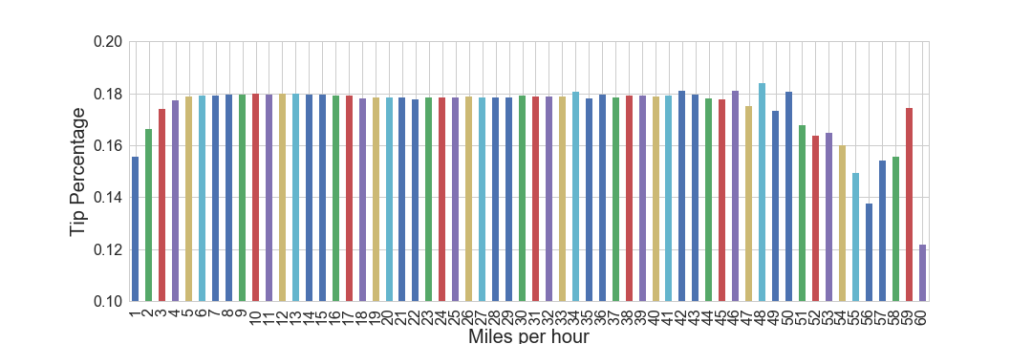
Tipping Behaviour

Slide 40
Tipping Behaviour

Slide 41
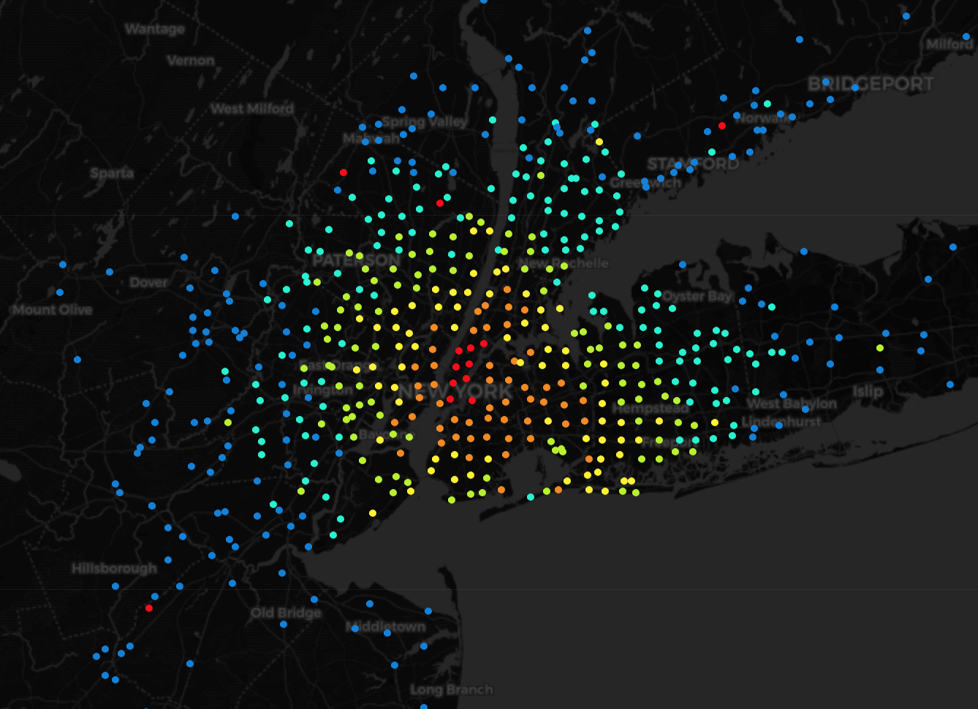
Distance by Dropoff Location
Tip Percentage
< 10 %
> 10 %
> 12.5%
> 15% > 17.5% > 20 %

Slide 42
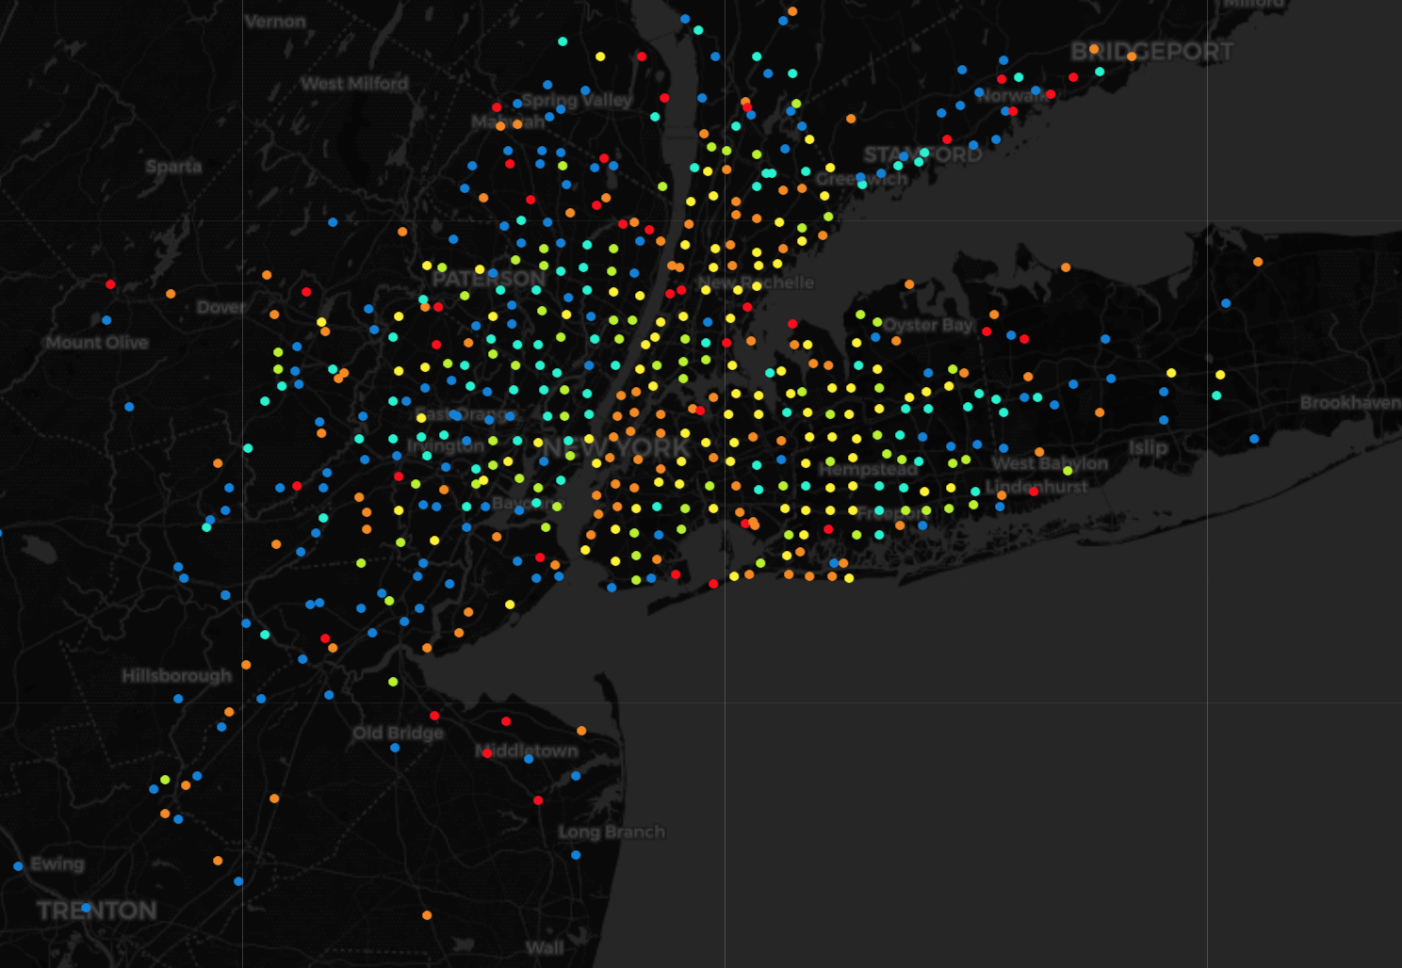
Tip Percentage by Dropoff Location
> 30 miles
> 20 miles
> 15 miles
> 10 miles > 5 Miles < 5 Miles

Slide 43
Tip Prediction - Features
Used
Tried
Longitude / Latitude
Subtotal
Average Speed
Weekday
Pickup time
Trip Distance
Pickup / Dropoff Area
Passenger count
Overnight
Rush Hour

Slide 44
Model Comparison – Tipping (MAE)

Slide 45
Model Comparison – Tipping (MAE)

Slide 46
LGBM - Individual Models (MAE)

Slide 47
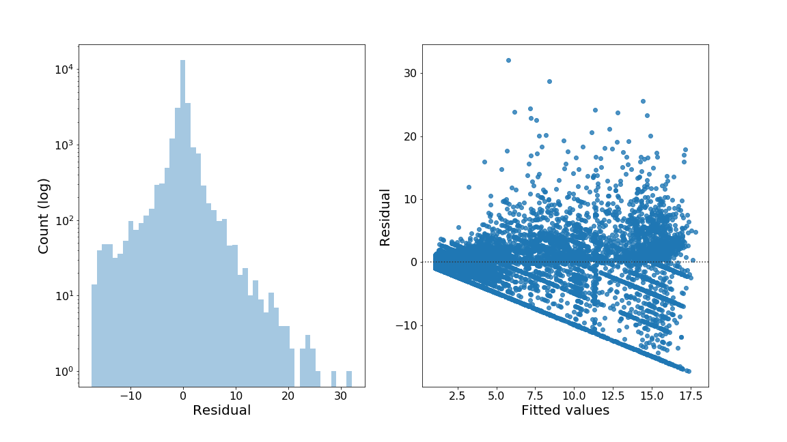
Tip Prediction - Evaluation

Slide 48
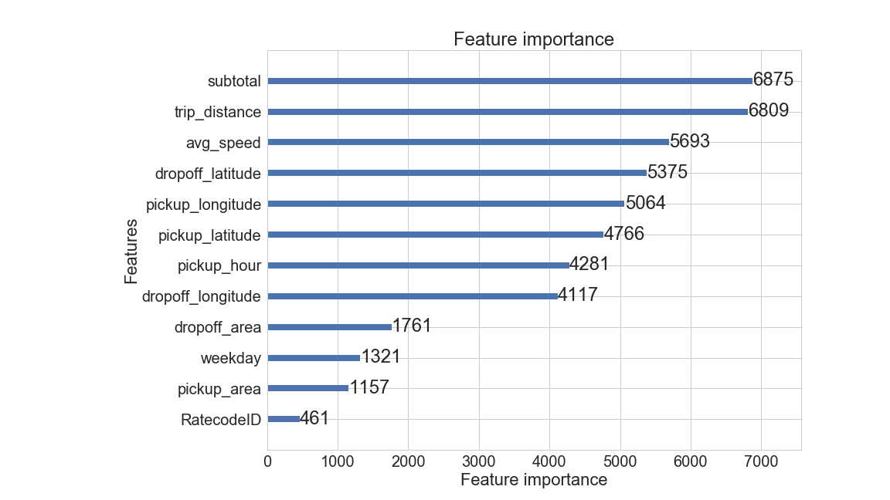
Tip Prediction - Evaluation

Slide 49
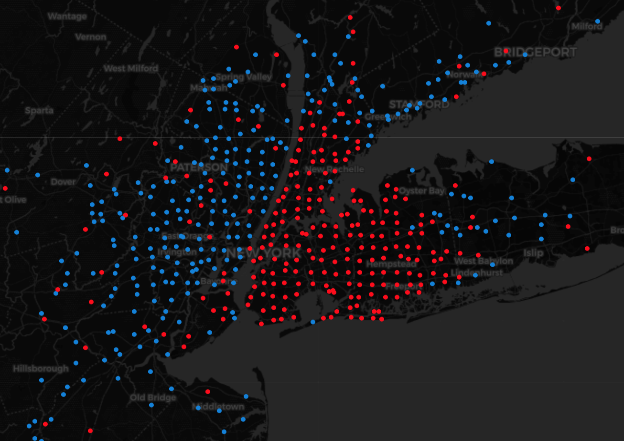
MTA Tax Prediction

Slide 50
MTA Tax Prediction
Ratecodes have homogeneous tax
SVM also assumes homogeneous tax
Alternative: Calculate dropoff polygons
=> insignificant error

Slide 51
Extra Prediction

